Slide 1
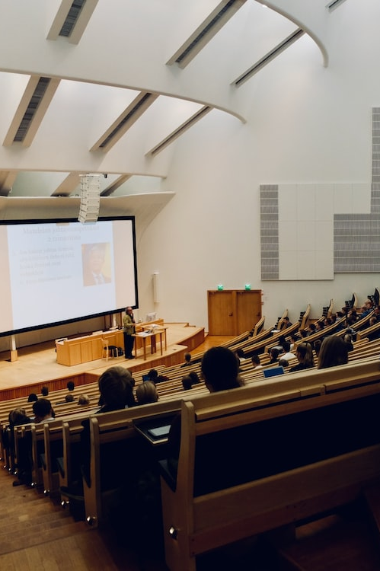
SUSTAINABLE AGRICULTURE CAREERS
The Australian government should invest more money in promoting careers in sustainable agriculture.

Slide 2
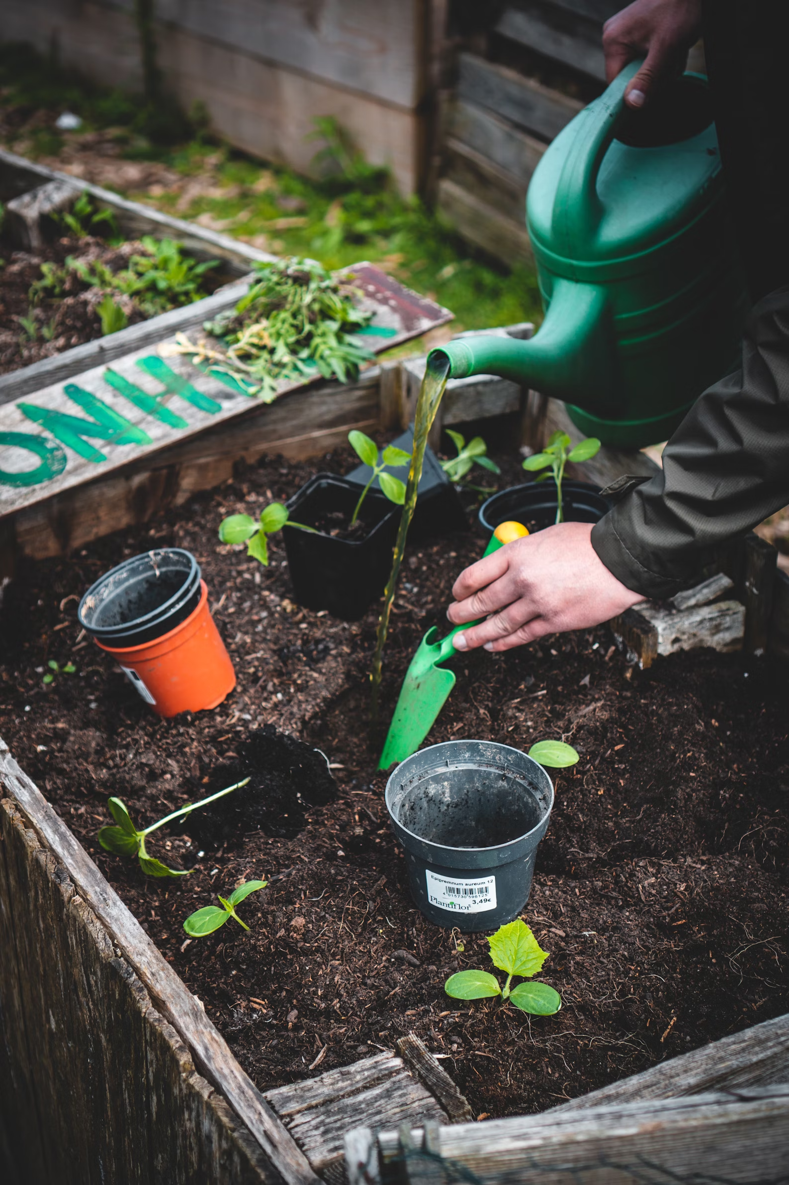
URBAN GARDENS
The development of urban gardens should be incentivised to increase local food production and awareness.

Slide 3
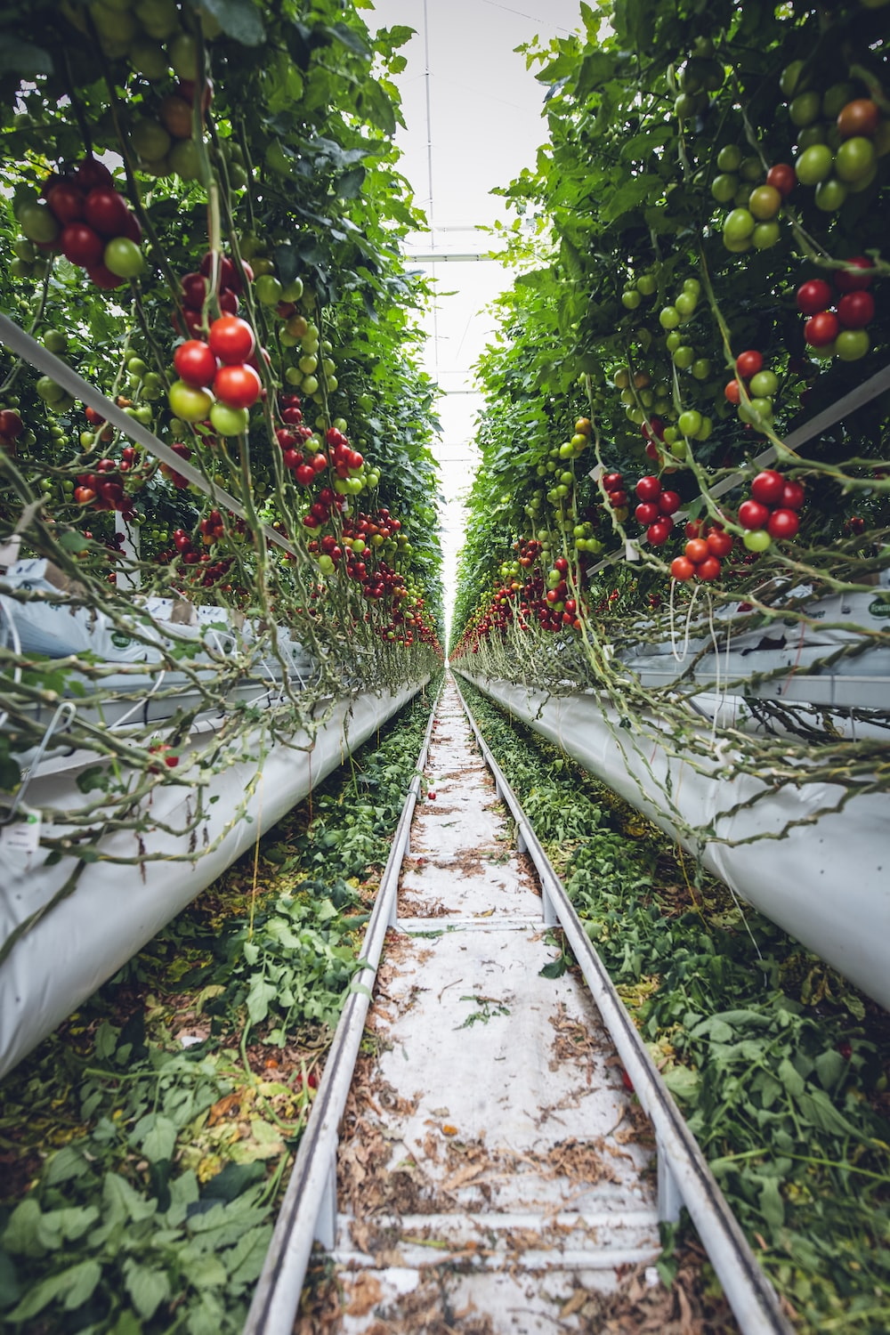
VERTICAL FARMING
Research into and investment in vertical farming technologies should be funded to help to produce food in urban environments more efficiently.

Slide 4
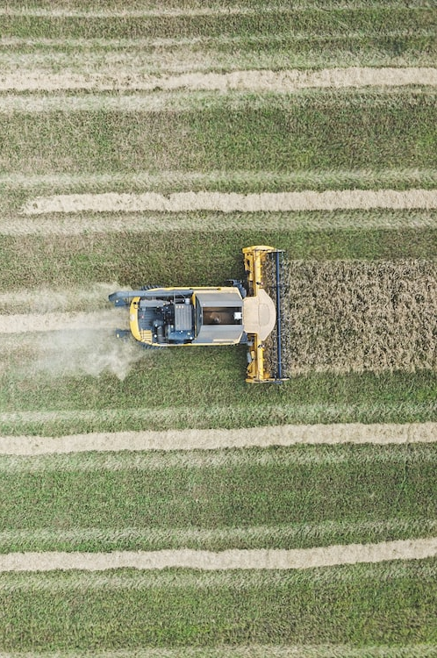
AGRICULTURE TECHNOLOGY
The Australian government should fund the development of agricultural technologies that can increase crop yields with lower water and fertiliser inputs.

Slide 5
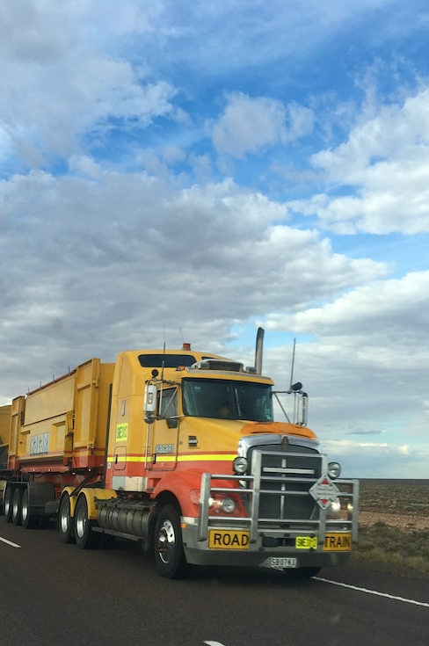
TRANSPORTATION SYSTEMS
Australia should invest in infrastructure to transport food more efficiently across the country.

Slide 6
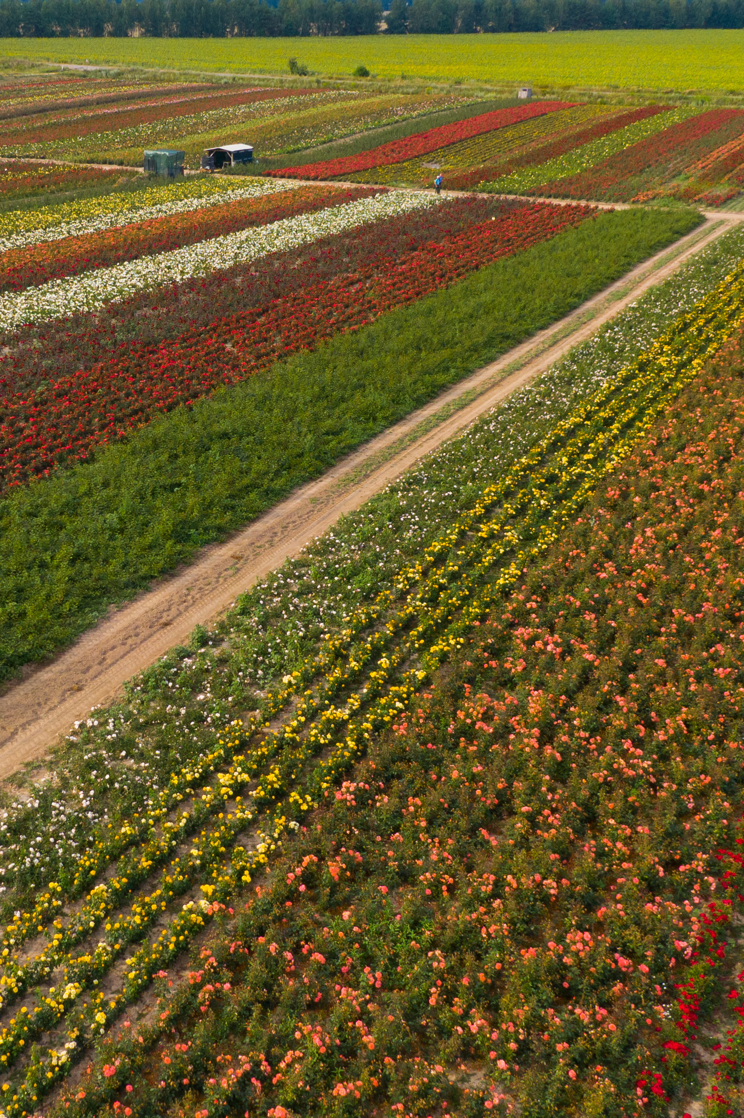
CROP DIVERSIFICATION
Strategies to diversify Australia’s crops should be adopted to make crops more resilient to pests, diseases, and climate change.

Slide 7
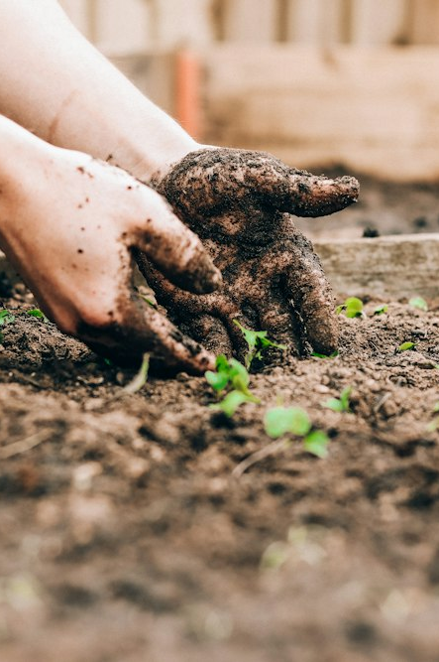
EDUCATION PROGRAMS
Education programs aimed at teaching children about sustainable food consumption should be developed to lay the foundation for long-term food security.

Slide 8
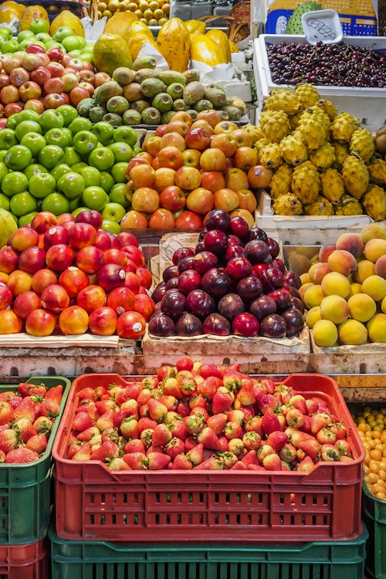
PRICING REGULATIONS
The Australian government should enforce pricing regulations to ensure that people can access healthy foods for affordable and reasonable prices.

Slide 9
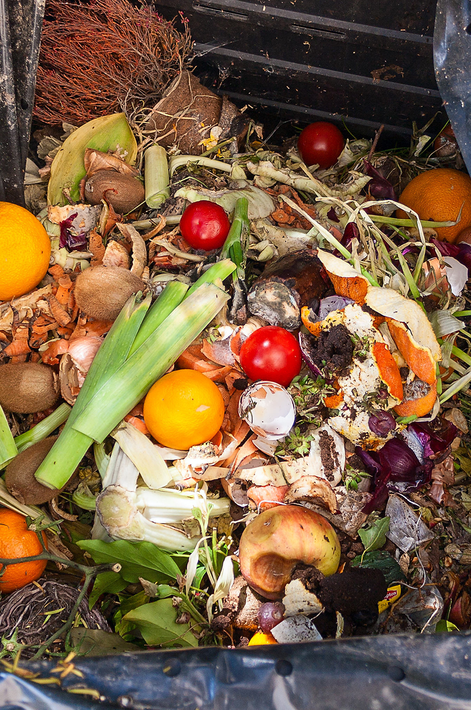
COMMUNITY INITIATIVES
Community initiatives to reduce food waste should be encouraged and financially supported by local councils.

Slide 10
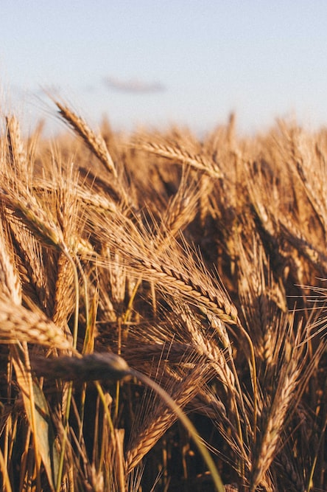
FARMING SUBSIDIES
The Australian government should introduce subsidies for farmers who adopt drought-resistant crop varieties to ensure consistent food production.

Slide 11
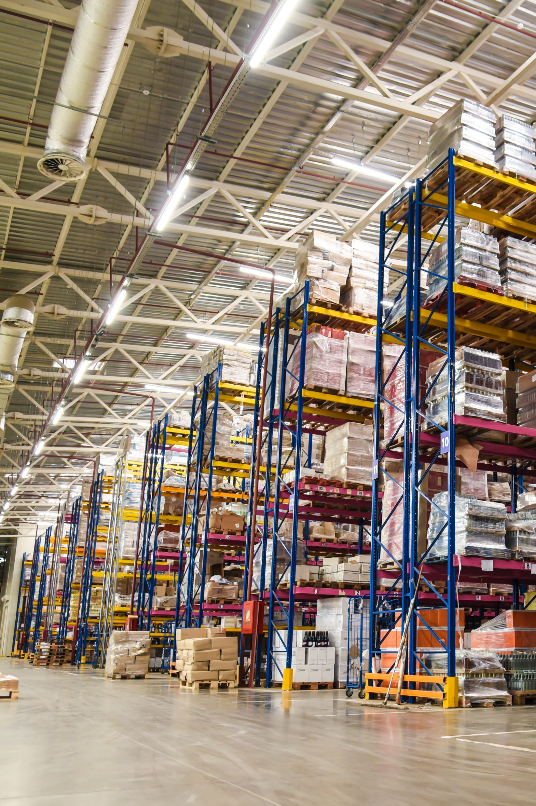
FOOD STORAGE
Australia should enhance its food storage facilities to decrease spoilage and loss, especially in disaster-prone areas.

Slide 12
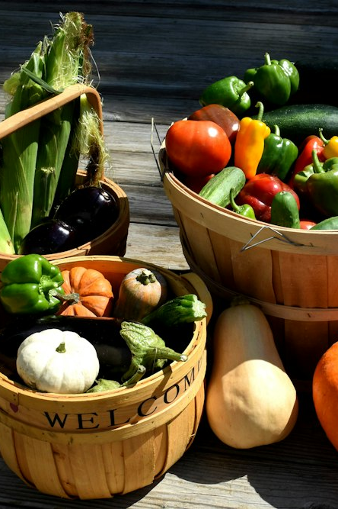
PUBLIC AWARENESS
Public awareness campaigns should be launched to educate consumers about the importance of eating seasonal and locally-sourced food.

